Slide 1
Naïve Bayesian
"Naive Bayes algorithm." Naive Bayes is a classification algorithm based on Bayes' theorem, which a probabilistic theorem is named after the mathematician Thomas Bayes.
The "naive" part of Naive Bayes comes from the assumption that features used to describe an observation are independent of each other. In reality, this assumption may not always hold true, but the algorithm is called "naive" because it simplifies the calculation and makes the algorithm computationally efficient."
Naive Bayes is a classification algorithm based on Bayes' theorem. It assumes that the features used for classification are independent, simplifying calculations. Despite this simplification, it often works well for tasks like spam detection, where it calculates the probability of an observation belonging to a particular category and makes predictions based on the highest probability.

Slide 2
Difference between Decision tree & naïve bayes
Decision Tree
Decision tree is a discriminative model.
Decision trees work better with lots of data compared to Bayes. Decision tree mainly deals with the Yes or No type of results and it limits the output to certain extent only.
Decision trees are more flexible and easy. Decision tree pruning may neglect some key values in training data, which can lead the accuracy for a toss.
If you don't know your classifiers, a decision tree will choose those classifiers for you from a data table. Naive Bayes requires you to know your classifiers in advance.
Naïve Bayes
Naive bayes is a generative model.
Bayes does quite well when the training data doesn't contain all possibilities so it can be very good with low amounts of data.

Slide 3
Naïve Bayes
To calculate the probability that an event will occur, given that another event has already occurred, we use Bayes’ Theorem.
To calculate the probability of an outcome given the value of some variable, that is, to calculate the probability of a hypothesis(h) being true, given our prior knowledge(d), we use Bayes’ Theorem as follows:
P(y|x)= (P(x|y) * P(y)) / P(x)
where
P(y|x) = Posterior probability. The probability of hypothesis y being true, given the data x, where P(h|d)= P(d1| h)* P(d2| h)*....*P(dn| h)* P(d).
P(x|y) = Likelihood. Conditional Probability of the given data sample.
P(y) = Target Class prior probability. The probability of hypothesis h being true (irrespective of the data).
P(x) = Predictor prior probability. Probability of the data (irrespective of the hypothesis).

Slide 4
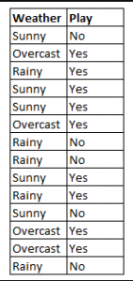
Using Figure 4 as an example, what is the outcome if weather=’sunny’?
To determine the outcome play= ‘yes’ or ‘no’ given the value of variable weather=’sunny’.
Calculate P(yes|sunny) and P(no|sunny) and choose the outcome with higher probability.
->P(yes|sunny)= (P(sunny|yes) * P(yes)) / P(sunny)
= (3/9 * 9/14 ) / (5/14)
= 0.60
-> P(no|sunny)= (P(sunny|no) * P(no)) / P(sunny)
= (2/5 * 5/14 ) / (5/14)
= 0.40
Thus, if the weather =’sunny’, the outcome is play= ‘yes’.
Figure 4: Using Naive Bayes to predict the status of ‘play’ using the variable ‘weather’.

Slide 5

Naïve Bayesian
RID | Age | Income | Student | Credit Rating | Class: Buys-Computer
1 | Youth | High | No | Fair | No
2 | Youth | High | No | Excellent | No
3 | Middle-aged | High | No | Fair | Yes
4 | Senior | Medium | No | Fair | Yes
5 | Senior | Low | Yes | Fair | Yes
6 | Senior | Low | Yes | Excellent | No
7 | Middle-Aged | Low | Yes | Excellent | Yes
8 | Youth | Medium | No | Fair | No
9 | Youth | Low | Yes | Fair | Yes
10 | Senior | Medium | Yes | Fair | Yes
11 | Youth | Medium | Yes | Excellent | Yes
12 | Middle-aged | Medium | No | Excellent | Yes
13 | Middle-aged | High | Yes | Fair | Yes
14 | Senior | Medium | No | Excellent | No

Slide 6
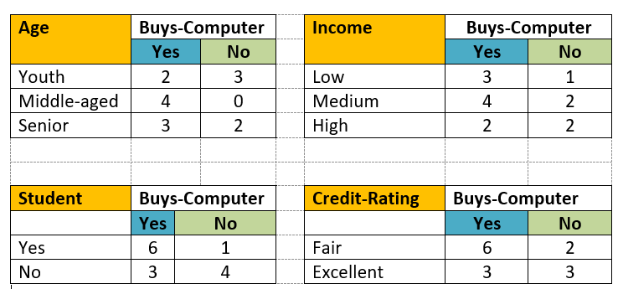
Naïve Bayesian

Slide 8
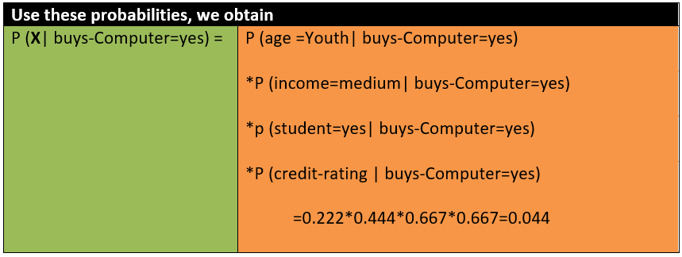
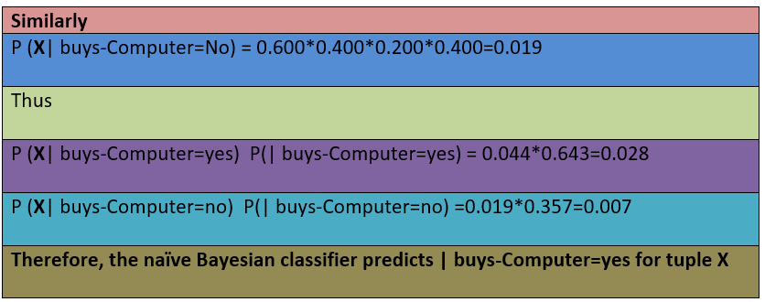

Slide 9
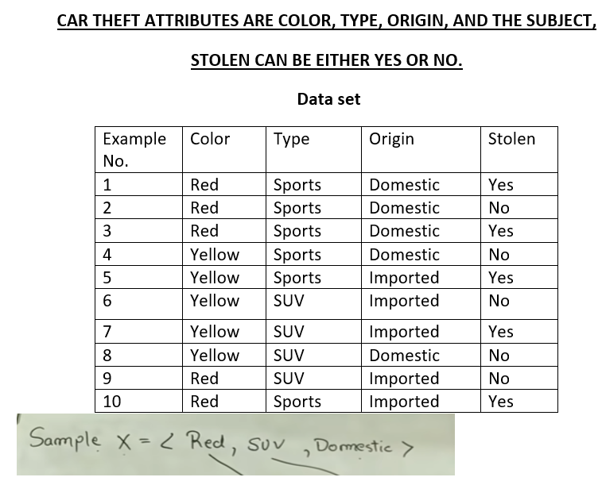
Do it yourself now
https://www.saedsayad.com/naive_bayesian.htm

Slide 10
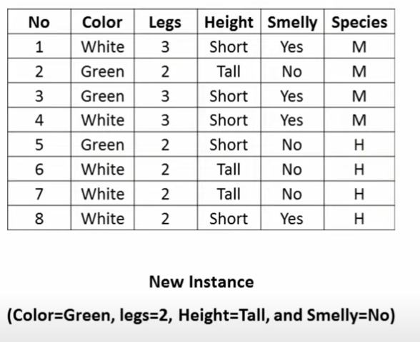
Do it yourself now
Estimate probability of new instance for species classes {M,H}

Slide 11
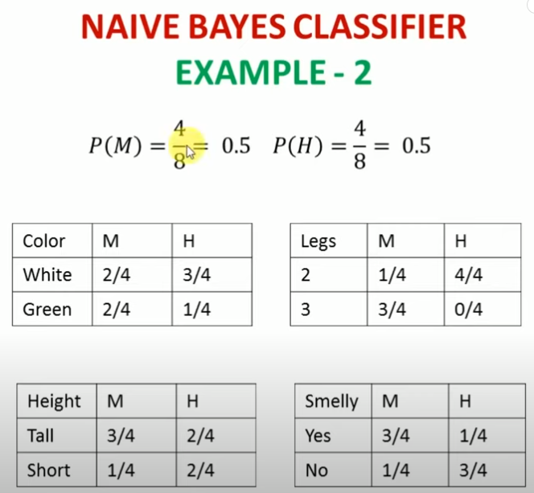
https://www.youtube.com/watch?v=z8K-598fqSo&t=152s

Slide 12
